Slide 1


Asp.Net Core – Razor Pages
ASP.Net Core Web Developer Program @ Aitrich Academy
Notes:
Hello everyone. Welcome to Aitrich Academy. Today we are discussing about Razor Pages in Asp.Net Core

Slide 2

What are Razor Pages?
Razor Pages is a server-side, page-centric programming model for building web UI with ASP.NET Core.
Client Content
Server Code
Notes:
What are Razor Pages :
Razor Pages, in ASP.NET Core, is a server-side, page-centric programming model designed for building web UI. It simplifies web development by offering a straightforward and intuitive approach to creating dynamic and interactive web pages. Let's dive into the key concepts and advantages of Razor Pages in our discussion.

Slide 3
Razor Pages
An ASP.NET Razor page has the “.cshtml” (e.g., “Index.cshtml”) file extension.
This file contains a mix of HTML and Razor syntax. The Razor syntax is actually C# code mixed together with the HTML code.
The Razor parts of the file are executed on the web server before the page is sent to the client (your web browser).
The Razor page may also have a C# code file linked to it, this file has the extension
In Razor with Page Model each Razor page is a pair of files:
Notes:
Razor Pages
Let's uncover the inner workings of an ASP.NET Razor Page:
File Extension: Every Razor Page has a special name like 'Index.cshtml,' and it always ends with '.cshtml'. This extension is like a signature, saying, 'Hey, I'm a Razor Page!'
Mix of HTML and Razor Syntax: Inside this '.cshtml' file, it's a blend of regular webpage code (HTML) and some special instructions written in C#, known as Razor syntax. It's like having magic code that adds functionality and interactivity to the webpage.
Execution on the Server: The Razor parts (the C# mixed with HTML) are like secret instructions for the computer. They get executed on the computer, which we call the web server, before the webpage is sent to your browser. This ensures that the webpage is dynamic and does what it's supposed to do.
Additional C# Code File: Sometimes, there's another file linked to the Razor Page, and it has a '.cs' extension. This file contains extra instructions in the C# language. It collaborates with the '.cshtml' file to ensure that the webpage behaves exactly as intended.
In Razor with Page Model, each Razor Page is like a dynamic duo - the '.cshtml' file and its linked '.cs' file working together to create a captivating webpage

Slide 4

Benefits of Razor Pages
Makes it easy to get started building dynamic web apps with html,css and c#
Encourages organization of files by feature, which eases maintenance of your app
Html + server-side c# code by using Razor syntax
Notes:
Benefits of Razor Pages
Now, let's uncover the advantages of using Razor Pages in ASP.NET:
Easy to Get Started:
Razor Pages make it a breeze to start building dynamic web applications. You get to use familiar tools like HTML, CSS, and C# to create engaging and interactive web pages. It's a friendly entry point for developers, especially those new to web development.
Encourages Organized Files:
One standout feature is its encouragement of organizing files by feature. This means grouping related files together, making it easier to find and maintain them. It's like having a neat and organized toolbox – everything has its place, which eases the maintenance of your app over time.
HTML + Server-Side C# Code:
With Razor Pages, you can seamlessly blend HTML with server-side C# code using Razor syntax. This allows you to create dynamic and responsive web pages without the need for complex setups. It's a powerful combination that simplifies the development process.
These benefits collectively contribute to a smooth and efficient development experience.

Slide 5
When to use Razor Pages
Blazor
MVC
Razor Pages
Appropriate for client-heavy SPA(single page app) scenarios as React and Angular
Server-side,organized by controllers,more structured scenarios,original basis of
Razor pages
Server-side applications that are organized by feature,Easy to start,scales to large applications.
Notes:
When to use Razor Pages
Let's explore the ideal scenarios for Razor Pages:
Blazor:
Great for client-heavy SPAs (Single Page Apps), akin to popular frameworks like React or Angular.
MVC:
Suited for server-side applications, especially those organized around controllers. It's the original foundation of Razor Pages, offering a more structured approach.
Razor Pages:
Perfect for server-side applications, particularly when organized by feature. It excels in simplicity for quick start-ups and gracefully scales to handle larger projects.

Slide 6

Razor Pages
Razor page use a markup language called Razor for embedding server-based code into webpages.
Razor syntax is combination of html and c# where the c# code defines the dynamic rendering logic for the page.
In a webpage that uses the razor syntax,there can be two kind of content:Client content and Server Code
Notes:
Razor Pages
Let's demystify Razor Pages and how they leverage a unique markup language called Razor:
Razor Markup Language:
Razor Pages use a markup language known as Razor for embedding server-based code into webpages. It's like the special tool that helps us blend server-side logic seamlessly with the webpage.
Razor Syntax:
The magic happens in the Razor syntax, a harmonious blend of HTML and C#. This combination allows us to define dynamic rendering logic for the page using familiar HTML tags and C# code. It's a powerful duo that makes web development more expressive and flexible.
Two Kinds of Content:
In a webpage using Razor syntax, we encounter two types of content:
Client Content: This is the regular HTML content that the browser understands and displays.
Server Code: The C# code within the Razor syntax, defining dynamic behavior. This code runs on the server before the webpage reaches the client's browser.

Slide 7

Razor Pages
Client Content : Contains what you are used to in webpages.For example,HTML markup (elements),style information such as CSS, maybe some client script such as javascript , and plain text
Server Code : Razor enables you to add server code to your client contrent.if there is server code in the page,the server runs that code first , before it sends the page to the browser
Notes:
Razor Pages
Let's break down the two fundamental components within Razor Pages: Client Content and Server Code.
Client Content:
This contains what you're already familiar with in webpages - HTML markup with elements, style information like CSS, perhaps some client-side scripts such as JavaScript, and plain text. It's what the browser understands and displays.
Server Code:
With Razor, you can seamlessly embed server code into your client content. This is where the magic happens. If there's server code in the page, the server runs that code first before sending the page to the browser. It allows you to inject dynamic behavior and logic into your webpage.

Slide 8
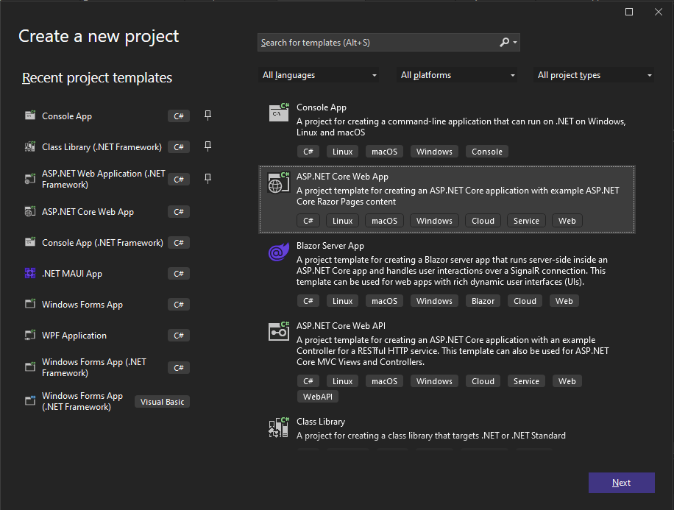
Creating a ASP.NET Core Web App
Notes:
Creating a ASP.NET Core Web App
Let's take a quick tour on creating an ASP.NET Core Razor Pages web app using Visual Studio. Follow these steps:
Open Visual Studio:
Fire up Visual Studio and ensure you have the 'ASP.NET and web development' workload installed.
Create New Project:
Click on 'Create a new project' and choose 'ASP.NET Core Web Application.'
Select Razor Pages Template:
Choose the 'ASP.NET Core Web App' template and make sure to select 'Razor Pages.' Click 'Next.‘
Configure Project:
Give your project a name, choose a location, and decide if you want to create a new Git repository. Click 'Create.'

Slide 9
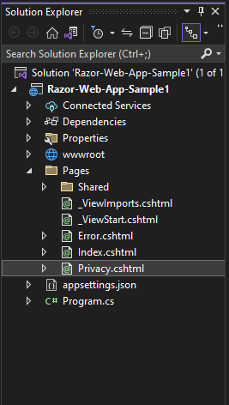
Project Structure
appSettings.json – This file contains configuration data, such as connection strings.
Program.cs – This file contains the entry point for the program. ,it configures app behavior.
wwwroot folder - Contains static files, such as Images, HTML files, JavaScript files, and CSS files.
Pages folder – Here you are supposed to put your ASP.NET (".cshtml") web pages
_Layout.cshtml file configures UI elements common to all pages. You can use this file to set up the navigation menu at the top of the page
Notes:
Project Structure
Understanding the structure of your ASP.NET Core Razor Pages project is key. Let's explore the essential components:
appSettings.json:
This file is like a configuration hub, storing crucial data like connection strings. It centralizes settings that your application needs to function, making it easy to manage.
Program.cs:
Acting as the entry point, Program.cs is where the program starts. It's not just the beginning; it configures how your app behaves. You can think of it as the director setting the stage for your web application.
wwwroot Folder:
Inside this folder, you find static files like images, HTML files, JavaScript files, and CSS files. It's the place to store assets that don't need processing but are directly served to the client.
Pages Folder:
Here is the heart of your Razor Pages application. The Pages folder is where you'll put your ASP.NET ('.cshtml') web pages. Each page can handle its logic, and this structure encourages organization.
Layout.cshtml File:
This file is like the maestro orchestrating the common elements for all pages. Layout.cshtml lets you set up elements shared across multiple pages, such as the navigation menu at the top. It ensures a consistent and cohesive user interface.

Slide 10
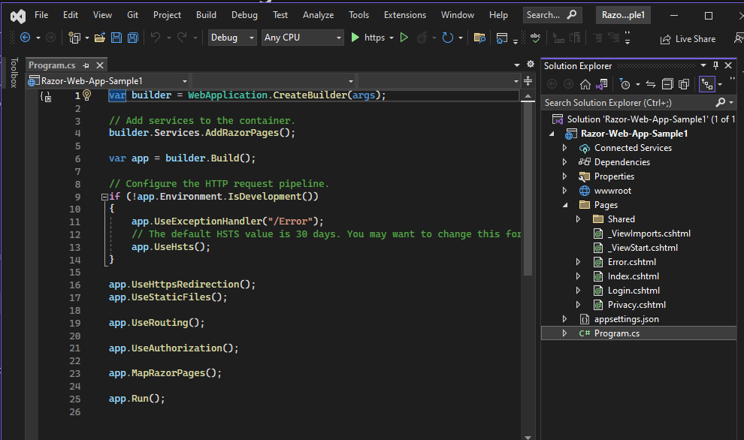
Razor Pages is enabled in program.cs
AddRazorPages adds services for Razor Pages to the app.
MapRazorPages adds endpoints for Razor Pages to the IEndpointRouteBuilder.
Notes:
Razor Pages is enabled in program.cs
In your ASP.NET Core Razor Pages project, enabling Razor Pages is a crucial step, and it happens in the Program.cs file. Let's delve into the process:
AddRazorPages:
The AddRazorPages method is like flipping the switch to enable Razor Pages services in your app. This line of code adds the necessary services that Razor Pages depend on, setting the stage for their seamless integration into your application.
MapRazorPages:
After adding services, you need to map endpoints for Razor Pages to the IEndpointRouteBuilder. The MapRazorPages method is responsible for precisely that. It adds the routes for Razor Pages, making them accessible through the specified URL paths.
These lines of code in your Program.cs file essentially configure your application to recognize and handle Razor Pages. It's like telling your application, 'Hey, Razor Pages are here, and here's how to deal with them.'

Slide 11

Razor page Anatomy
In Razor with Page Model each Razor page is a pair of files: ​
A “.cshtml” file that contains HTML markup with C# code using Razor syntax.​
A “.cshtml.cs” (“code behind” or “Page model” file) file that contains C# code that handles page events.
Notes:
Razor Page Anatomy:
In the realm of Razor Pages, understanding their anatomy is fundamental. Each Razor Page, especially in the Razor with Page Model approach, consists of a pair of files:
'.cshtml' File:
This is the HTML markup file where the visual elements of your page reside. However, it's not just static HTML; it's infused with C# code using Razor syntax. This combination allows you to embed dynamic content and logic directly within your HTML, making your web pages responsive and interactive.
'.cshtml.cs' File (Code-Behind or Page Model):
This is like the behind-the-scenes maestro orchestrating the functionality. The '.cshtml.cs' file contains C# code that handles various page events and functionalities. It's where you define the logic that responds to user interactions, manages data, and controls the behavior of the page. It's the brainpower behind the visual presentation.

Slide 12
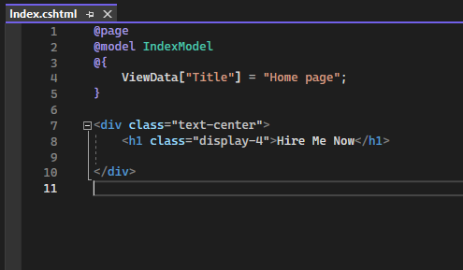
Razor page – .cshtml page
This code looks a lot like a Razor view file used in an ASP.NET Core app with controllers and views. What makes it different is the @page directive.
@page makes the file into an MVC action, which means that it handles requests directly, without going through a controller. @page must be the first Razor directive on a page. @page affects the behavior of other Razorn constructs. Razor Pages file names have a .cshtml suffix.
The @model directive specifies the model type made available to the Razor page
Notes:
Razor page – .cshtml page
Examining the '.cshtml' page in a Razor Page is like deciphering a familiar code with a unique twist. Here's what sets it apart:
Similarity to Razor Views:
At first glance, the code resembles a typical Razor view file used in ASP.NET Core apps with controllers and views. It combines HTML markup with embedded C# code using Razor syntax, creating a dynamic and expressive web page.
@page Directive:
What makes it distinct is the presence of the '@page' directive. This directive transforms the file into an MVC action, indicating that it handles requests directly without going through a controller. It's a defining feature of Razor Pages, and '@page' must be the first Razor directive on a page. Its presence influences the behavior of other Razor constructs.
.cshtml Suffix:
Razor Pages file names end with a '.cshtml' suffix, distinguishing them from standard HTML files. This suffix signifies that the file contains both HTML and embedded C# code, creating a dynamic and interactive web page.
@model Directive:
The '@model' directive specifies the model type available to the Razor page. It's like declaring the data structure that the page interacts with, providing a clear understanding of the page's expectations and functionalities.

Slide 13

Rendering HTML
The default Razor language is HTML. Rendering HTML from Razor markup is no different than rendering HTML from an HTML file. HTML markup in .cshtml Razor files is rendered by the server unchanged.
Notes:
Rendering HTML
When it comes to rendering HTML in Razor Pages, it's important to understand that the default Razor language is HTML itself. Let's break down the process:
Default Razor Language:
In Razor Pages, the default language is HTML. This means that rendering HTML from Razor markup is no different than rendering HTML from a standard HTML file. The server processes and renders HTML markup from '.cshtml' Razor files without any alterations.
Server Unchanged Rendering:
HTML markup within '.cshtml' Razor files is rendered by the server unchanged. This ensures consistency and reliability in displaying web content. The server acts as the powerhouse, dynamically serving the HTML content to the client browser exactly as it's written in the Razor file.

Slide 14
Razor syntax
Razor is a markup syntax for embedding .NET based code into webpages. The Razor syntax consists of Razor markup, C#, and HTML. Files containing Razor generally have a .cshtml file extension. Razor is also found in Razor component files (.razor). Razor syntax is similar to the templating engines of various JavaScript single-page application (SPA) frameworks, such as Angular, React, VueJs, and Svelte.
Razor supports C# and uses the @ symbol to transition from HTML to C#. Razor evaluates C# expressions and renders them in the HTML output.
When an @ symbol is followed by a Razor reserved keyword, it transitions into Razor-specific markup. Otherwise, it transitions into plain HTML.
To escape an @ symbol in Razor markup, use a second @ symbol:
Notes:
Razor Syntax:
Razor Syntax is the powerhouse of dynamic content creation in ASP.NET Core. Let's dive into the key aspects:
Markup Syntax for Embedding .NET Code:
Razor is a markup syntax designed for seamlessly embedding .NET-based code into webpages. It's the bridge that connects the worlds of C# and HTML, allowing them to coexist harmoniously.
Composition of Razor Syntax:
The Razor syntax encompasses Razor markup, C#, and HTML. Files using Razor generally carry a '.cshtml' extension. It's also prevalent in Razor component files with a '.razor' extension. This flexibility makes Razor syntax versatile for various scenarios in ASP.NET Core.
Similarity to SPA Frameworks:
Razor syntax bears similarities to templating engines in popular JavaScript single-page application (SPA) frameworks like Angular, React, VueJs, and Svelte. This makes it easier for developers familiar with these frameworks to transition into ASP.NET Core development.
C# Expressions and @ Symbol:
Razor supports C# and uses the '@' symbol to transition between HTML and C#. When '@' is followed by a Razor reserved keyword, it signals a transition into Razor-specific markup. Otherwise, it smoothly transitions into plain HTML. This dual-role of '@' symbol adds dynamism to the Razor syntax.
Escaping @ Symbol:
To escape an '@' symbol in Razor markup, you use a second '@' symbol. This ensures that the '@' is treated as a literal character rather than a transition indicator.

Slide 15
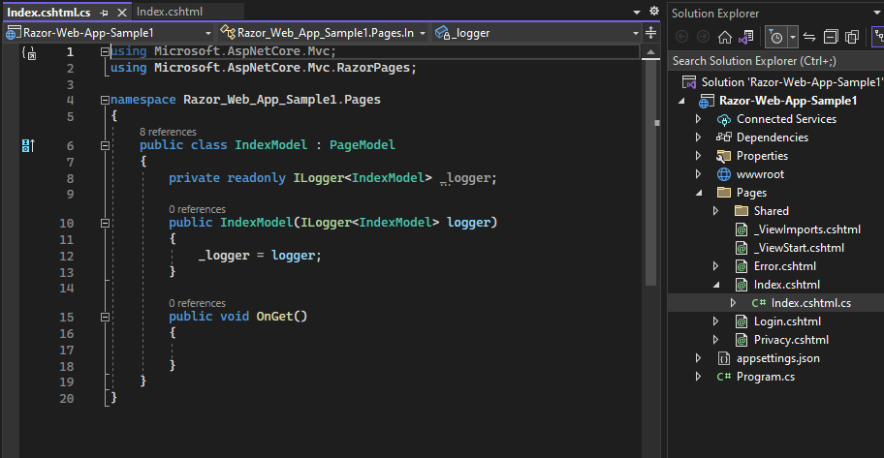
PageModel - .cshtml.cs page
By convention, the PageModel class file has the same name as the Razor Page file with .cs appended.
This is the logic Part of the page .
Page events can be manage here
Encapsulates the data properties and logic operations scoped just to its Razor page.
Defines page handlers for HTTP requests sent to the page and for the data used to render the page.
OnGet to initialize state needed for the page.
OnPost to handle form submissions.
Notes:
PageModel - .cshtml.cs page
When we talk about the '.cshtml.cs' file in Razor Pages, we're referring to the PageModel. This file plays a crucial role in handling page-related logic and operations. Let's explore its key features:
OnPost and OnGet Methods:
The PageModel contains methods like 'OnPost' and 'OnGet' to handle specific actions. 'OnPost' is often used to manage form submissions, while 'OnGet' initializes the state needed for the page. These methods define the behavior of the page when it receives HTTP requests.
Page Handlers and Data Rendering:
The PageModel defines page handlers for HTTP requests sent to the page and manages the data used to render the page. It encapsulates both the handling of incoming requests and the preparation of data for rendering, making it a central hub for page-related activities.
Encapsulation of Data and Logic:
One of the strengths of the PageModel is its ability to encapsulate data properties and logic operations scoped specifically to its associated Razor page. This encapsulation ensures a clean and organized structure for managing the intricacies of the page.
Managing Page Events:
Page events, like the lifecycle events of the page, can be managed within the PageModel. This allows developers to execute specific actions at different points in the page lifecycle, ensuring precise control over page behavior.
Logic Hub of the Page:
In essence, the PageModel is the logic part of the page. It orchestrates how the page responds to user actions, processes data, and interacts with the server.
Naming Convention:
By convention, the PageModel class file has the same name as the Razor Page file with '.cs' appended. This convention simplifies the association between the Razor Page and its corresponding PageModel.

Slide 16

Notes:
Thank you for joining this session!

